Slide 1
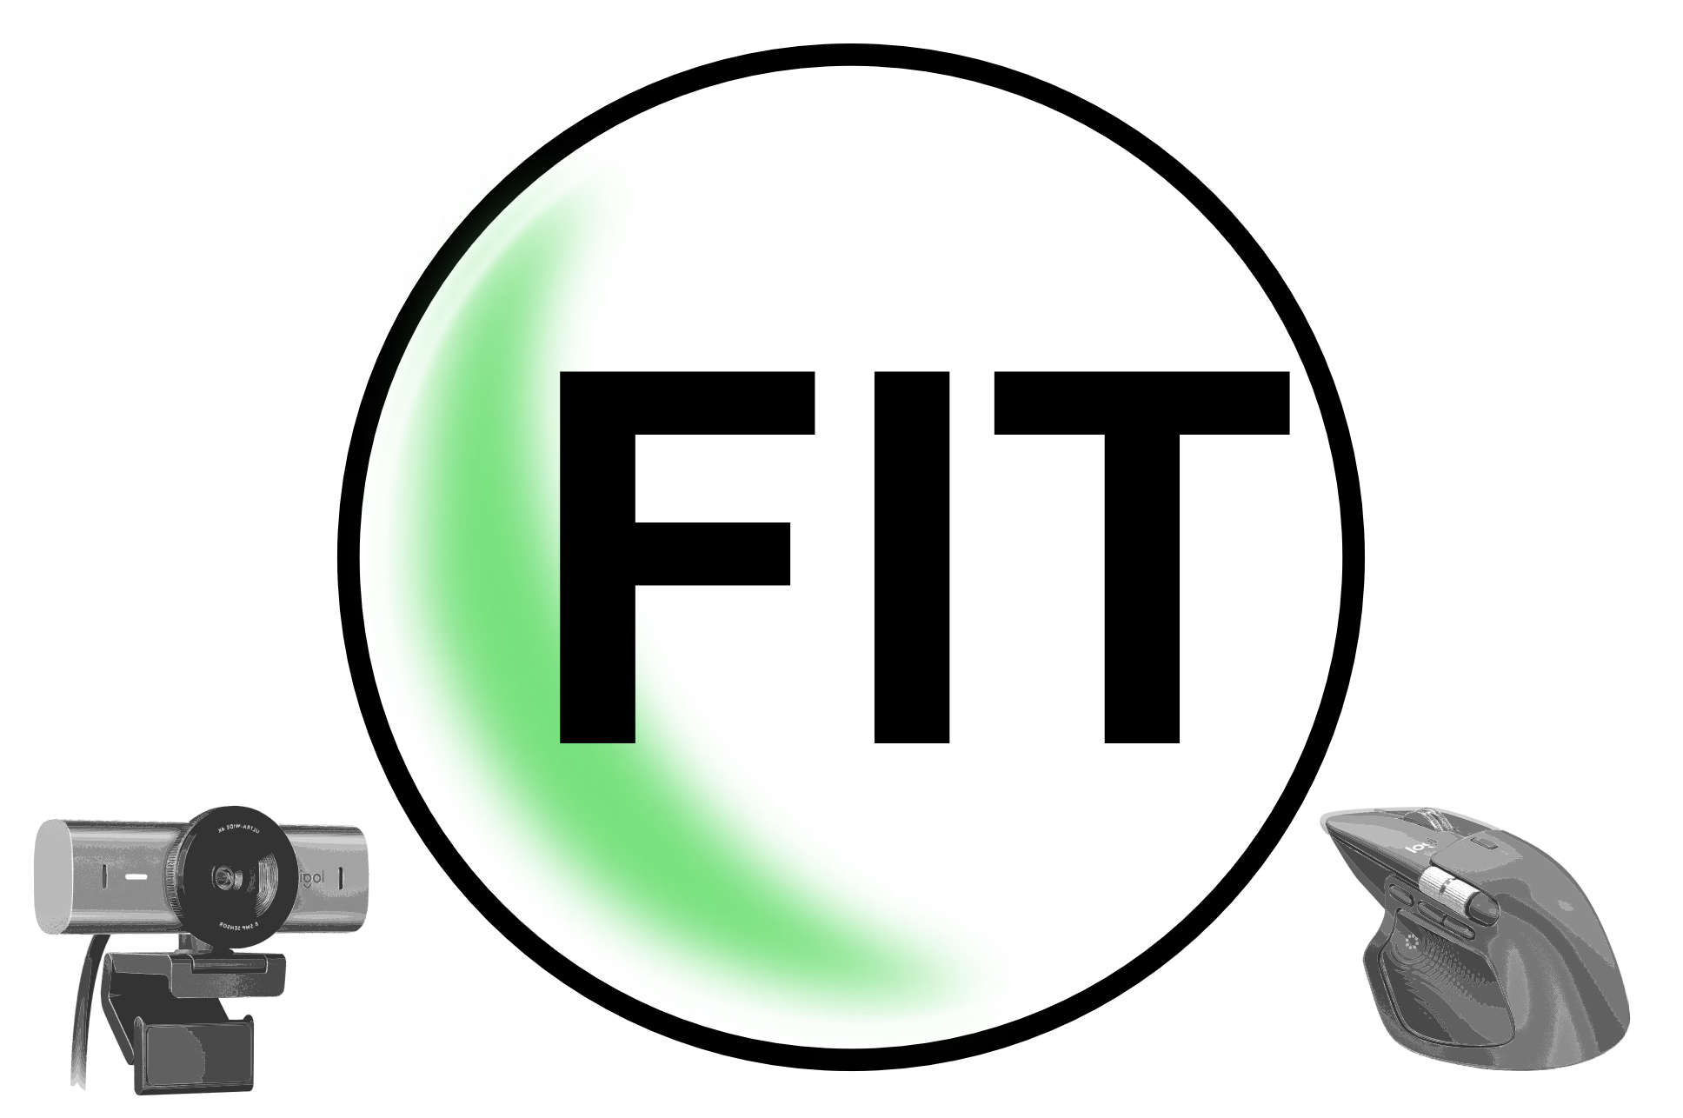
NFun

Slide 2
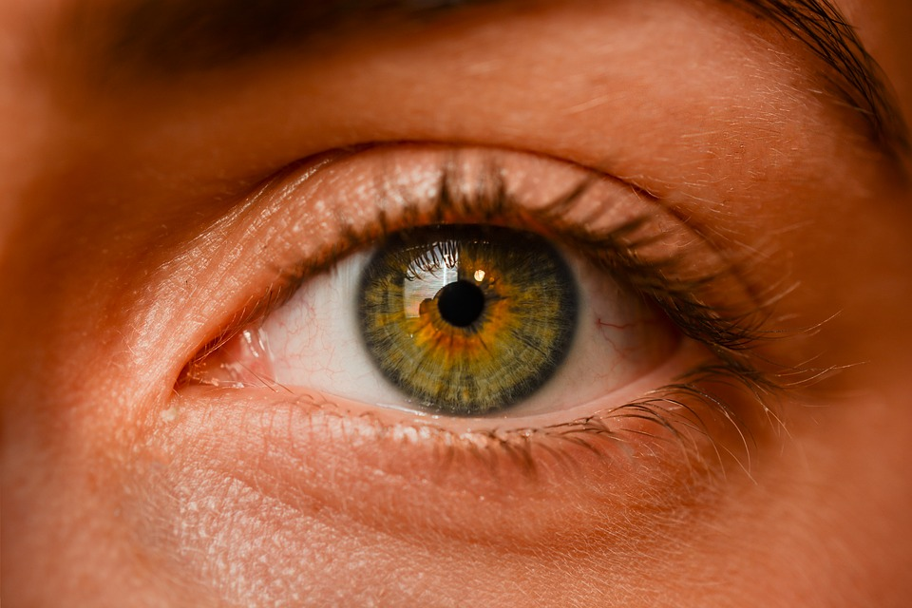


20-20-20 Rule [1]
25% of workers are feeling stress which negatively impacts them [2]
80% of american adults don‘t meed recommended guidelines for physical activities [3]
"Dieses Foto" by Unknown is licensed using CC BY-SA
Notes:
The eyelid beat rate decreases, often leading to fatigue and symptoms such as dryness, itching, blurred vision, and headaches. Furthermore, constantly looking at close objects like a screen may exacerbate the development of nearsightedness.
In 2020, 25% of employed people felt exposed to psychological stress. It should be taken into account that the COVID-19 pandemic may also have had an impact on well-being in working life.

Slide 3
Our Solutions
👀 Vision Guard: Intelligent reminders prevent digital eye strain during long work sessions.
🫁 Haptic Breathwork: Follow rhythm-based vibrations on your mouse to lower stress levels instantly.
🧘‍♂️ Interactive Yoga Trainer: Real-time pose detection checks your form and counts down your hold time automatically.

Slide 4
Sources
[1] https://www.uniklinik-freiburg.de/presse/publikationen/im-fokus/2023/wie-schaedlich-ist-digitales-arbeiten-fuer-die-augen.html (23.11.2025)
[2] https://www.destatis.de/DE/Themen/Arbeit/Arbeitsmarkt/Qualitaet-Arbeit/Dimension-1/stress-arbeitsplatz.html (23.11.2025)
[3] https://pmc.ncbi.nlm.nih.gov/articles/PMC9733787/ (23.11.2025)

